Slide 1
TASK-4 Data Storytelling & StatisticalValidation
Sales Performance Analysis
Prepared By
Gorle Vikesh kumar

Slide 2
Business Objective
The objective of this analysis is to evaluate the company's sales performance across different regions, product categories, and customer segments. The analysis aims to identify high-performing business areas, understand profit distribution, and provide actionable recommendations that support data-driven decision-making and improve overall business performance.

Slide 3
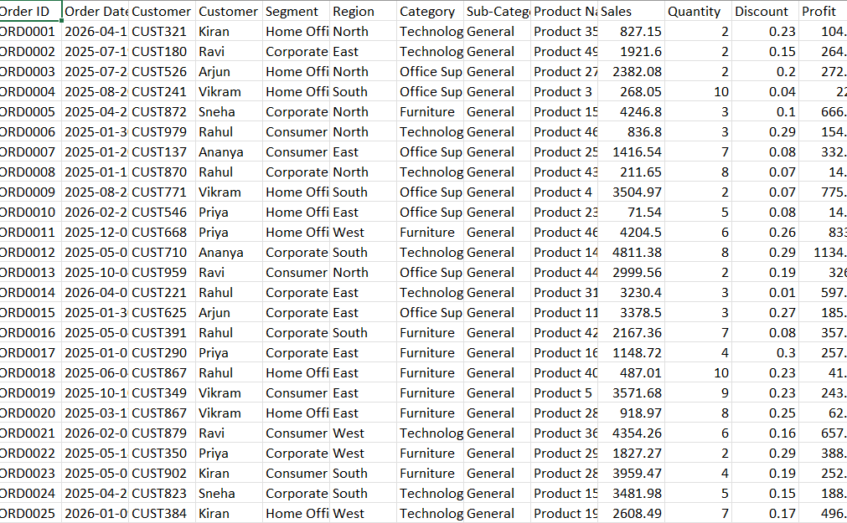
Dataset Overview
Dataset Includes
Order Details
Sales Amount
Profit
Discount
Product Category
Customer Segment
Region
Monthly Sales

Slide 4
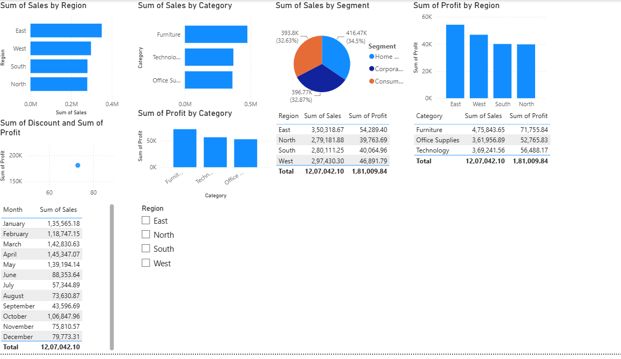
Dashboard Overview
Dashboard Components
Sales by Region
Sales by Product Category
Sales by Customer Segment
Profit by Region
Profit by Category
Monthly Sales Analysis
Discount vs Profit Analysis

Slide 5
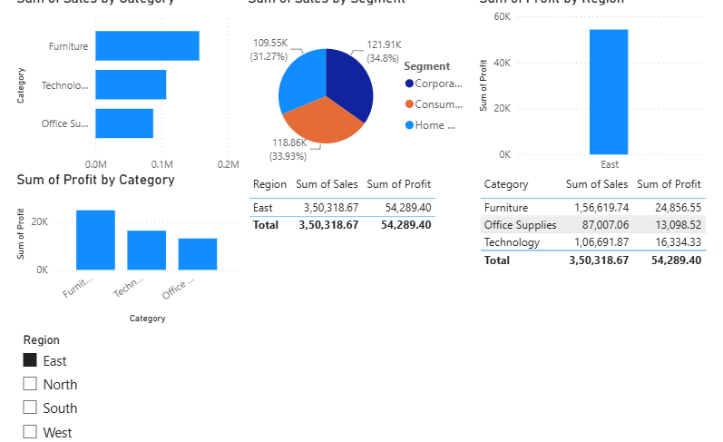
Regional Sales Analysis
Regional Performance Analysis
The dashboard indicates that the East region generated the highest sales and profit among all regions.
Key Findings
East recorded the highest sales (₹3.50 Lakhs).
West ranked second in sales.
South and North generated comparatively lower sales.
East also achieved the highest profit.
Business Insight
The East region is the company's strongest market and should continue receiving strategic investment, while North and South require additional promotional efforts to increase sales.

Slide 6
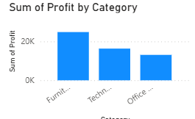
Product Category Analysis
Findings
Furniture generated the highest sales.
Technology ranked second in sales.
Office Supplies showed consistent performance.
Furniture also produced the highest profit.
Business Insight
Furniture is the company's most profitable category and should remain a key focus for inventory planning and marketing campaigns.

Slide 7
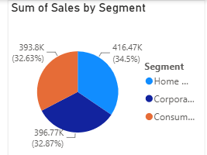
Customer Segment Analysis
Customer Segment Analysis
The business serves three major customer segments.
Segment Contribution
Home Office – 34.5%
Corporate – 32.9%
Consumer – 32.6%
Business Insight
Sales are evenly distributed across all customer segments. This balanced customer base reduces dependency on a single market segment and creates opportunities for growth across multiple customer groups.

Slide 8
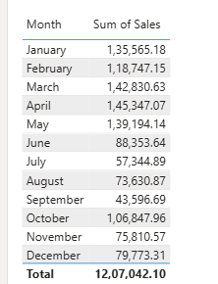
Monthly Sales Analysis
Monthly Sales Trend
Monthly sales analysis highlights seasonal variations throughout the year.
Highest Sales Months
March
April
May
Lowest Sales Months
July
August
September
Business Insight
The business experiences seasonal fluctuations in demand. Marketing campaigns and promotional offers should be planned during low-performing months to improve sales consistency.

Slide 9
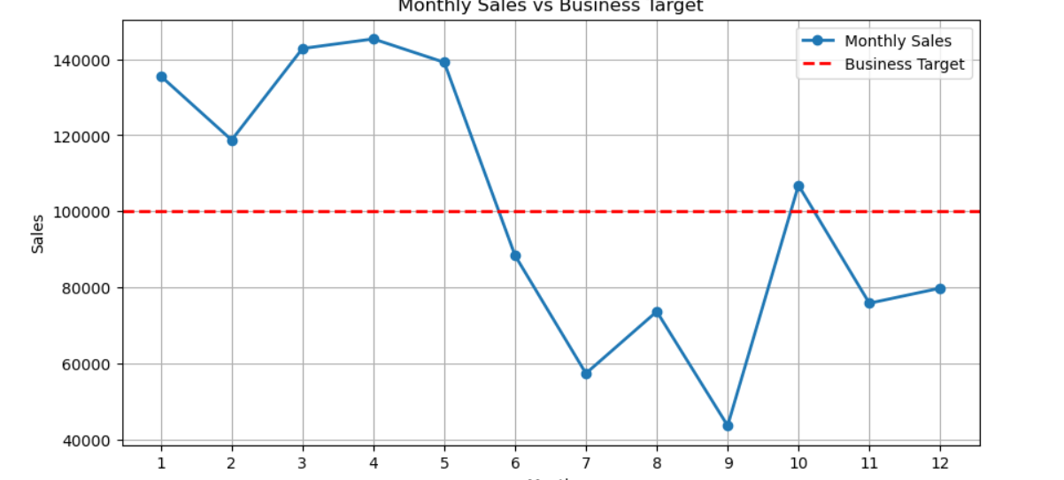
Hypothesis Testing
Null Hypothesis (H₀)
There is no statistically significant difference between the average monthly sales and the business target.
Alternative Hypothesis (H₁)
There is a statistically significant difference between the average monthly sales and the business target.
Statistical Test Used
One-Sample T-Test
Decision Rule
If p-value < 0.05, reject the Null Hypothesis.
If p-value ≥ 0.05, fail to reject the Null Hypothesis.
Graph Interpretation
Monthly sales exceeded the business target from January to May and again in October.

Slide 10

Business Recommendations
Based on the analysis, the following business strategies are recommended:
Increase investment in the East region to maximize revenue.
Strengthen marketing campaigns in North and South regions.
Expand the Furniture product line due to its high profitability.
Improve inventory management for high-demand products.
Launch promotional campaigns during low-sales months.
Optimize discount strategies to improve profit margins.
Reward loyal customers to improve customer retention.

Slide 11

Conclusion
The sales data analysis provided valuable business insights by identifying top-performing regions, product categories, and customer segments. These findings support data-driven decision-making and highlight opportunities to improve sales, profitability, and overall business growth through targeted strategies.

Slide 12
Thank You

